Slide 1


Construction project-Budget utilization dashboard
Project Financial Analysis & Insights
Created by Khuteja B

Slide 2
Project Overview
This project dashboard provides a complete financial overview of a construction project. It includes insights into project income, expenses, total cost, and net profit with visual data representation.
Key Highlights:
• Tracks total project income, expenses, and net profit.
• Displays detailed data on materials, labor, and other expenses.
• Uses Power BI visuals to monitor progress, performance, and financial status.
• Helps in understanding cost distribution and financial efficiency.

Slide 3
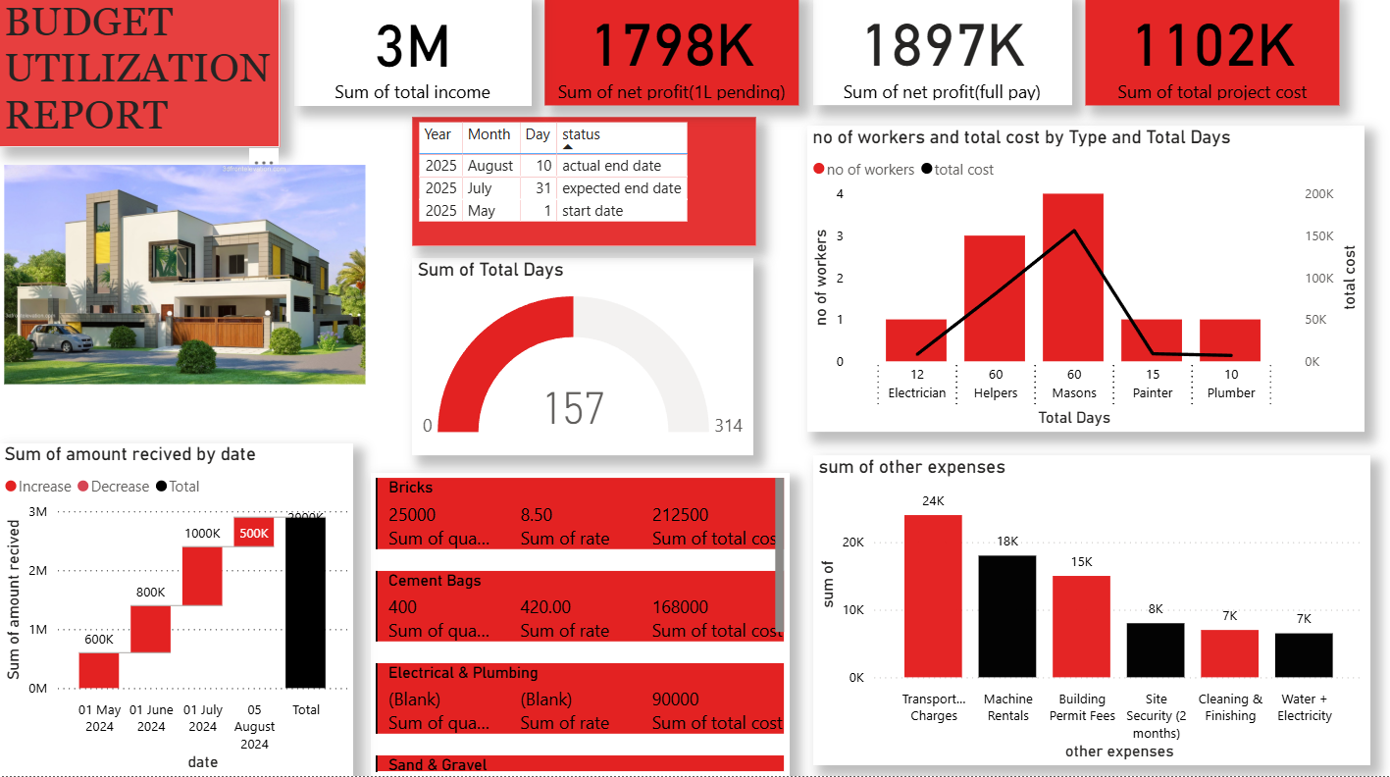
This dashboard provides a comprehensive view of a residential construction project’s financial and operational metrics. It includes income, profit, project cost, workforce distribution, and material expenses.

Slide 4
Key Metrics Summary
• Total Income: ₹3M
• Total Project Cost: ₹1.102M
• Net Profit: ₹1.897M
• Pending Profit: ₹1L
• Total Days: 157 (out of 314 planned)
These metrics help evaluate the financial health and project progress efficiently.

Slide 5
Tools & Skills Used
• Tools: Power BI, MS Excel
• Skills: Data Cleaning, Data Modeling, DAX Formulas, Data Visualization, Dashboard Design
• Purpose: To create an interactive dashboard showcasing project financial performance.
This dashboard demonstrates expertise in transforming raw data into actionable insights.

